Slide 1

DIGITAL TRANSFORMATION
Eng. Hany Mahmoud
Former Minister of Communications
& Information Technology
Egypt

Slide 2
CHALLENGES IN AFRICA
BUILDING CAPACITY
INVEST IN TECHNOLOGY
AFRICAN APPLICATIONS

Slide 3

WHAT IS DIGITAL TRANSFORMATION?
Digital transformation is the process of using digital technologies to create new - modify existing - business process, culture and customer experience to meet changing business and market requirements

Slide 4

What’s the difference between?
Digitization
Digitalization
Digital Transformation

Slide 5


DIGITIZATION
Is the move from analog to digital. Converting all of those ink-on-paper records to digital compute files

Slide 6

DIGITALIZATION
is using digital data to simplify how you work.
The process of using digitized information to make established ways of working simpler and more efficient

Slide 7

DIGITAL TRANSFORMATION
Is adding value to every customer interaction, changing the way business gets done and creating entirely new closes of business.

Slide 8
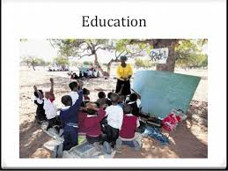


Education Evolution

Slide 9
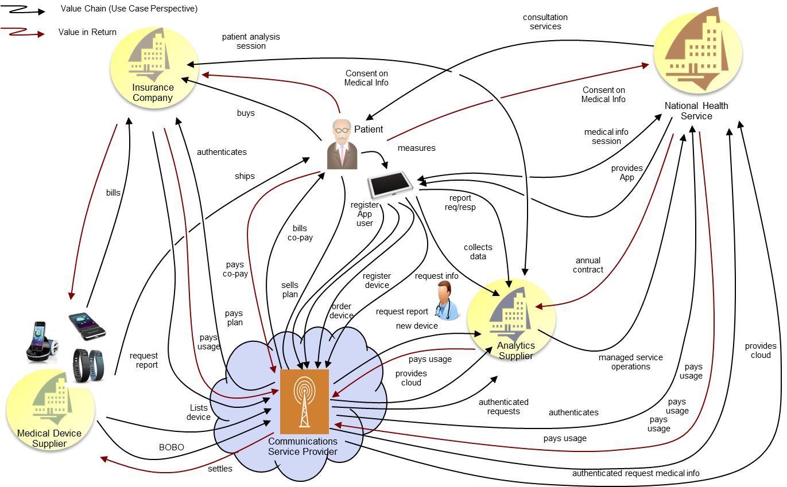
What is Hadoop eco-system?
Healthcare use case (TMForum)

Slide 10
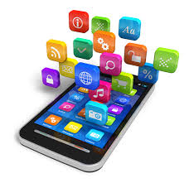

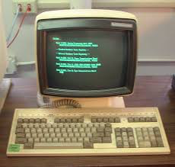
Digital Government Framework
Systems of Engagement,
Digital services & IoT use cases
Digital Services Platform: Public Cloud, Big Data , IoT & AI
Systems of Record

Slide 11
Digital Government Architecture
Education
& e-learning
e-government services
Health Care services
Traffic Management
Finance & Banking
Big Data & IoT Platforms
Public Cloud & API Management Platforms
API
GW
Storage
GW
API
GW
Storage
GW
API
GW
Storage
GW
Ministry-1
Ministry-2
Ministry-X
External Sources

Slide 12
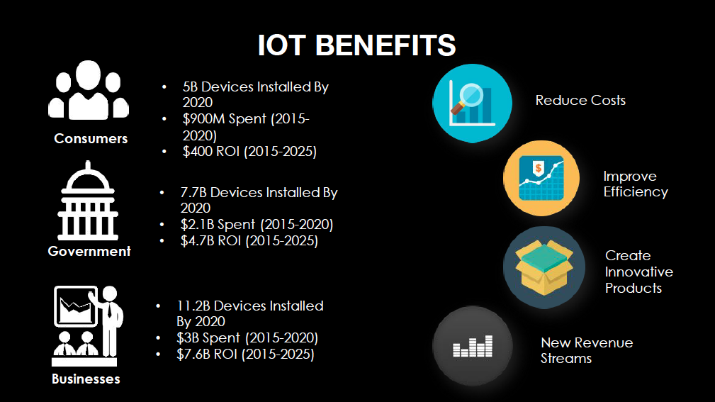
IoT Benefits

Slide 13
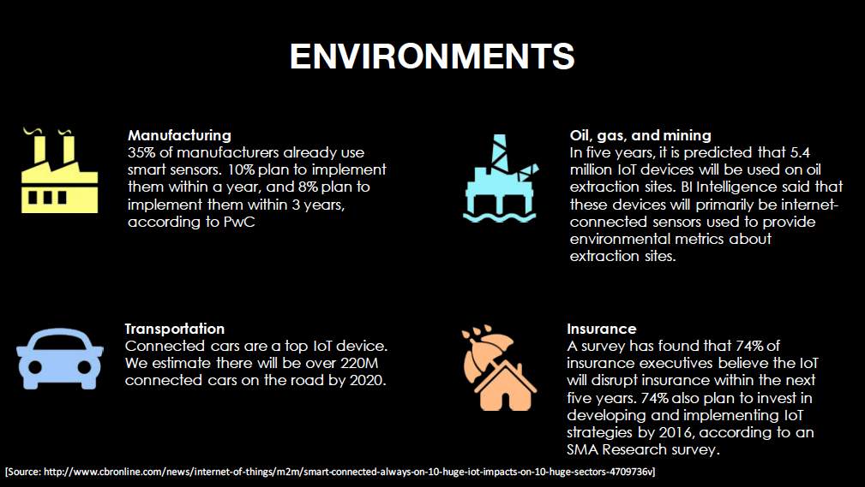
IoT Use Cases: 1 of 4

Slide 14
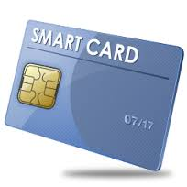
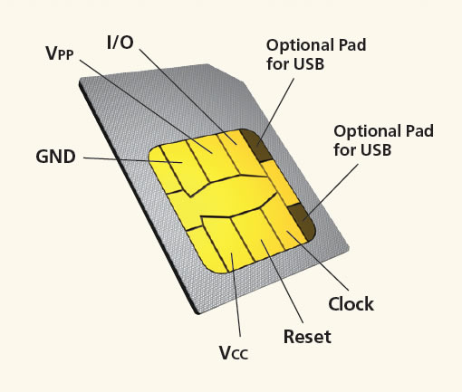
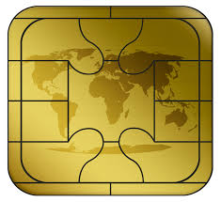
Smart Cards
VCC - power supply
RST - Reset signal, used to reset the card's communications.
CLK - Provides the card with a clock signal, from which data communications timing is
derived.
GND - Ground (reference voltage).
VPP - Programming voltage input - originally an input for a higher voltage to program
persistent memory (e.g., EEPROM), but now deprecated.
I/O - Serial input and output (half duplex).
C4, C8 - The two remaining contacts are AUX1 and AUX2 respectively, and used
for USB interfaces and other uses.

Slide 15
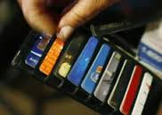
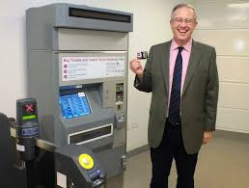
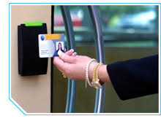
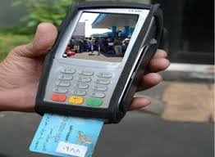

Multi-application cards
Advance smart card technology for seamless use of multi-application cards
Contribute to the development of innovative applications and services
Consumers feel they carry too many cards as it is.
They prefer carrying ONE smart card that can be used at multiple environments to carrying multiple cards, each with exclusive functionality at one environment.

Slide 16

6 BUILDING BLOCKS OF DIGITAL TRANSFORMATION
Create the right mindset and shared understanding
Put the right leaders in place
Formulate digital strategy to respond to opportunities & threats
Find, develop and acquire digital business skills and roles
Create new digital business capabilities

Slide 17
THANK YOU
Eng. Hany Mahmoud
hany228@gmail.com
+(20)1005009090

