Slide 1

AfICTA CEO Roundtable 2015
ICANN & Business

Slide 2
DISCUSSION POINTS
Overview of ICANN
ICAN Structure and Governance
Why Business Should be Concerned
About the Business Constituency
To Become a Member of the Business Constituency

Slide 3
ICANN
ICANN or the Internet Corporation for Assigned Names and Numbers is a global body with responsibility for certain policies that relate to the domain name system (DNS). Domain names are the names consumers and businesses rely upon to find websites for legitimate products and services on the Internet. Domain addresses are the addresses underlying the domain names
ICANN also oversees the IP Protocol as well as root servers

Slide 4
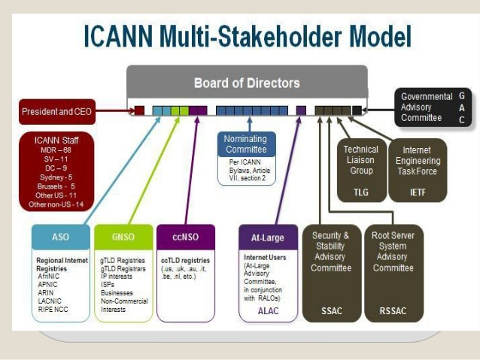
ICANN General Structure
Notes:
ICANNs Board of Directors: As a group, exercises the powers of ICANN, controls its property and conducts or directs its business and affairs.
Address Supporting Organization (ASO)
ALAC At-Large Advisory CommitteeALAC is responsible for providing policy advice on the activities of the ICANN, as they relate to the interests of individual Internetu sers (the "At-Large" community).
ccNSO The Country-Code Names Supporting Organization. The purpose of the ccNSO is to engage and provide leadership in activities relevant to country-code top-level domains (ccTLDs)
GNSO - Generic Names Supporting Organization. The GNSO is the body of seven constituencies:• Registry Stakeholder Group• Registrar Stakeholder Group• Commercial and Business Users• Intellectual Property Interests• Internet Service and Connection Providers• Non-Commercial Users• Not-for-Profit Operational
Governmental Advisory Committee (GAC)
Root Server System Advisory Committee (RSSAC)
Security and Stability Advisory Committee (SSAC

Slide 5
Why Businesses Should be Concerned
Internet should be private sector led multistakeholder
Can your business survive a failed or Unstable Internet or one that is not open?
Can your business survive an insecure Internet
Internet is the new marketplace, can your business afford to lose your business identity or undergo branding abuse/defensive registrations (e.g. .SUCKS)?
Be part of the discussion – cybersecurity; cybercrime, IPR, IANA Transition

Slide 6
Business Constituency
The Business Constituency (BC) is the voice of commercial Internet users within ICANN.
The BC is part of ICANN’s GNSO and also belongs to a larger group known as the Commercial Stakeholders Group (CSG)
Its activities include participation in the policy-making processes of ICANN
Leadership structure

Slide 7
To be a BC Member
Visit http://www.bizconst.org/ and download the application form
Fill in and return the form according to the instructions. Annual membership fee is tiered:
Company (which is not a micro enterprise); association spanning more than one ICANN region 1500 € / 1939 USD.
Association spanning one ICANN region (e.g. AfICTA) 670 € / 866 USD
Company which is a micro enterprise (both under 10 employees and underEuro 0.5 million turnover) 383 € / 495 USD

Slide 8

Thank you for your attention. Any questions on ICANN or the Business Constituency welcome

