Slide 1
IANA FUNCTIONS STEWARDSHIP TRANSITION
CEO ROUNDTABLE MEETING
BY
Mrs Mary Uduma
JUNE 10, 2015

Slide 2
ACRONYMS
IANA – Internet Assigned Names Authority
ICANN – Internet Corporation for Assigned Names and Numbers
ICG –IANA Transition Coordination Group
CWG IANA- Cross Community Working of IANA Transition on Names of ICANN
CCWG-ACCOUNTABILITY- Cross Community working Group on Enhancing ICANN Accountability.
IETF- Internet Engineering Task Force
RIR –Regional Internet Registry (IP address Registry)
IP – Internet Protocol

Slide 3
ACRONYMS 2
NRO – Number Resource Organization
ALAC –At-Large Advisory Committee
ISOC- Internet Society
RSSAC-Root Zone
SSAC- Security and Stablilistion Advisory Committee
ICC- International Chambers of Commerce
gTLD –Generic Top Level Domain
ccTLD- Country Code Top Level Domain

Slide 4
ACRONYMS 3
ccNSO- Country Code Names Supporting Organistion
GNSO- Generic Names Supporting Organisation
ASO- Address Supporting Organisation
GAC – Governmental Advisory Committee
IAB – Internet Architecture Board
DNS – Domain Name System

Slide 5
INTERNET OPERATIONAL COMMUNITIES
PROTOCOL PARAMETERS COMMUNITY – ISOC -IETF-IAB
NUMBERS COMMUNITY – NRO-RIR-ASO
NAMES COMMUNITY- DNS- ICANN AND ITS CONSITUENCIES: (GNSO,CCNSO,SSAC,RSSAC,ALAC,GAC, etc)

Slide 6


INTRODUCTION
The Internet depends on unique identifiers and sets of protocol parameters. The domain name of a website and IP address of a server are those unique identifiers.

Slide 7
WHAT ARE IANA FUNCTIONS
The Internet Assigned Numbers Authority (IANA) functions are a set of interdependent technical functions that enable the continued efficient operation of the Internet.

Slide 8
THE IANA FUNCTIONS
The Coordination of the Assignment of Technical Internet Protocol Parameters
The Administration of Certain Responsibilities Associated with Internet DNS Root Zone Management
The Allocation of Internet Numbering Resources
Other Services Related to the Management of the ARPA and INT Top-Level Domains (TLDs)

Slide 9
WHO’S IN CHARGE
The National Telecommunications and Information Administration (NTIA), under the US Government through the Department of Commerce is in charge of overseeing the organization responsible for the coordination of the Internet Domain Name System (DNS).
The NTIA had contracted Internet Corporation for Assigned Names and Numbers to carry out the IANA functions.

Slide 10
ICANN’S ROLE
Since 2000, ICANN has performed the IANA functions, on behalf of the U.S. government, through a contract with NTIA. This contract has been amended, extended and renewed over the years. The current version of the IANA contract, awarded by NTIA in July 2012, defines the following functions:
Coordination of the assignment of technical protocol parameters including the management of the address and routing parameter area (ARPA) TLD.
The administration of certain responsibilities associated with the Internet DNS root zone management, namely:

Slide 11
ICANN’S ROLE 2
The Administration of certain responsibilities associated with
The Internet DNS root zone management, namely:
Root Zone File Change Request Management
Root Zone “WHOIS” Change Request and Database Management
Delegation and Redelegation of a Country Code Top Level-Domain (ccTLD)
Delegation and Redelegation of a Generic Top Level Domain (gTLD)
Root Zone Automation
Root Domain Name System Security Extensions (DNSSEC) Key Management
Customer Service Complaint Resolution Process (CSCRP)
The allocation of Internet numbering resources:
To the Regional Internet Registries (RIRs)
Other services related to the management of the
ARPA and INT top-level domains (TLDs

Slide 12
ICANN’S ROLE 3
The above functions could be summarized as follows
a. Domain Name System Root Zone Management
b. Internet Number Registry Management
c Protocol Parameter Registry Management including management of the Addresses and Rooting Parameter AREA (ARPA ) TLD and
Management of the International Treaty Organization ( .INT) Top Level Domain

Slide 13
IANA TRANSITION
To support and enhance the multi-stakeholder model of Internet Policymaking and Governance, NTIA announced its intent to transition its stewardship of the IANA functions to the global multi-stakeholder community.
As outlined in the U.S. government’s press release, ICANN anticipates that the transition process of the U.S. government’s stewardship of the IANA Functions will be determined by a proposal developed by the multi-stakeholder community and will not be replaced any Government or intergovernmental solution.

Slide 14
IANA TRANSITION 2
ICANN was mandated by the US Government to convene a global multistakeholder process that will take over the oversight of IANA functions from NTIA
ICANN Accountability process must be enhanced prior to submitting an acceptable stewardship transition proposal to NTIA

Slide 15






What is the multistakeholder community?
“Stakeholder” refers broadly to anyone who has an interest in the Internet
Within ICANN, stakeholders include:
The multistakeholder community functions on bottom-up consensus building which, by design, is resistant to capture due to the openness, diversity and equal division of authority among participants
ICANN’s private sector-led multistakeholder community is directly responsible for the success of the Internet’s DNS
Large and small businesses
Technical community
Civil society
Governments
Researchers and academics
End users

Slide 16
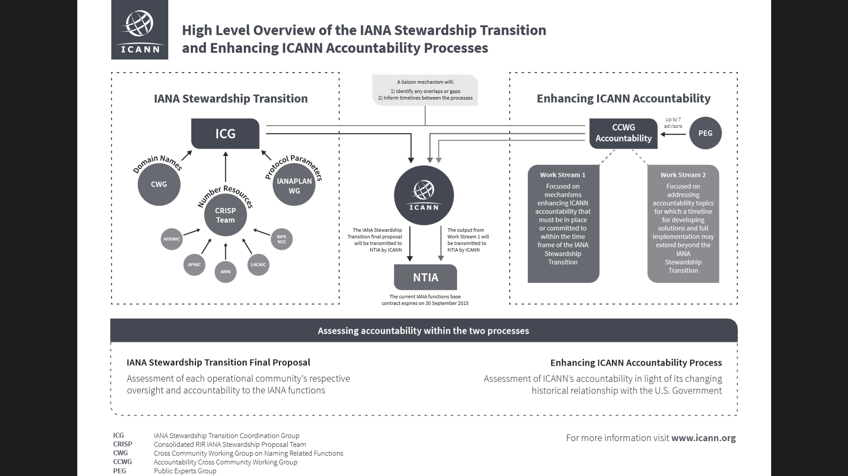
IANA STEWARDSHIP TRANSITION

Slide 17
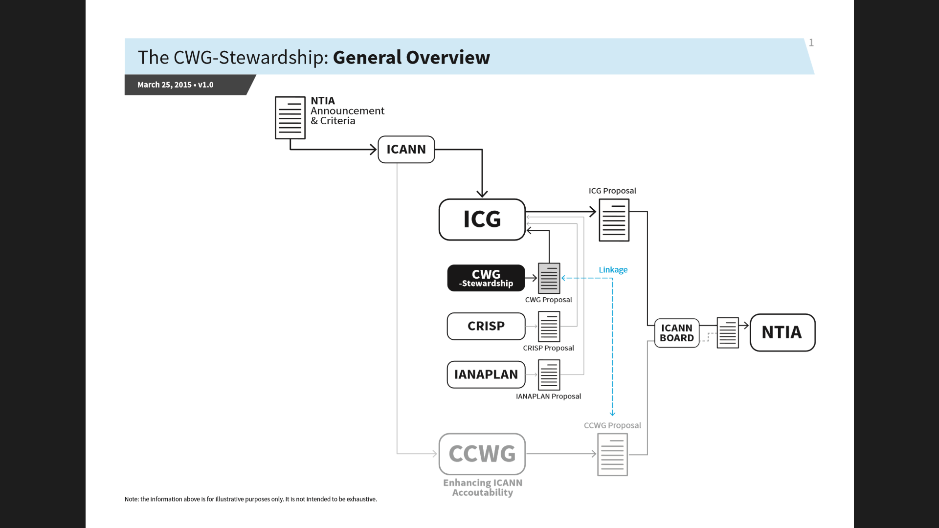
CWG –IANA STEWARDSHIP

Slide 18
IANA Stewardship Transition Coordination Group “ICG”
The Transition, ICG Mandate and Composition

Slide 19
Transition background
In March 2014, NTIA:
Announced intention to transition stewardship of IANA functions.
Asked ICANN to convene global stakeholders to develop a proposal to transition the current role played by NTIA.
ICANN process resulted in creation of:
IANA Stewardship Transition Coordination Group (ICG) in July 2014
CROSS COMMUNITY WORKING GROUP ON ENHANCING ICANN ACCOUNTBILITY (CCWG-ACCOUTABILITY)

Slide 20
ICG
ALAC
IAB
ASO
IETF
ISOC
ccNSO
NRO
GAC
RSSAC
GNSO
SSAC
gTLD registries
ICANN board liaison
ICC/BASIS
IANA staff liaison

Slide 21
ICG
ALAC
IAB
ASO
Coordinate
Liaise
Assess
Assemble
Inform
No proposal development
IETF
ISOC
ccNSO
NRO
GAC
RSSAC
GNSO
SSAC
gTLD registries
ICANN board liaison
ICC/BASIS
IANA staff liaison

Slide 22
Focus of transition
IANA functions currently specified in NTIA contract. IANA activities related to:
Protocol parameters registry management
DNS root zone management
Internet numbers registry management
Stewardship (not policy development, etc.)

Slide 23
Transition proposal development
RIR
communities
IETF
community
Naming
CWG

Slide 24
Steps towards a single proposal
Individual proposal assessment
Completeness
Clarity
NTIA criteria met
Community comments accommodated
Consensus level achieved
Inclusiveness of community process
ICG

Slide 25
Steps towards a single proposal
Unified proposal assessment
Compatability and interoperability
Gaps/overlaps
Accountability (under discussion)
ICG

Slide 26

Steps towards a single proposal
Proposal finalization
Public comment
ICG review
Changes in communities if necessary
Submission
ICG
ICG

Slide 27
IANA Stewardship Transition Process
Community Proposals and Engagement

Slide 28
Request for Proposals (RFP)
The IANA Stewardship Transition Coordination Group (ICG) released an RFP
Required Proposal Elements
Description of Community’s Use of IANA Functions
Existing, Pre-Transition Arrangements
Proposed Post-Transition Oversight and Accountability Arrangements
Transition Implications
NTIA Requirements
Community Process

Slide 29
Operational Communities
Complete proposals from processes convened by the ‘Operational Communities’
'Operational Communities' are communities with direct operational or service relationships with the IANA functions operator, namely:
Generic Names Supporting Organization (GNSO)
Country Code Names Supporting Organization (ccNSO)
Regional Internet Registries (RIRs)
Internet Architecture Board (IAB)
Internet Engineering Task Force (IETF)

Slide 30
Proposals Development
Operational communities are asked to:
Adhere to open processes, inclusive of all interested stakeholders
Actively reach out and encourage wider participation by parties interested in their response
Proposals developed should be supported by the broad range of participating stakeholders

Slide 31
NAMES Community Proposal
Final proposal to be submitted to the Chartering Organisations of ICANN on the 11th of June. ICG on the 25th of June.
https://community.icann.org/pages/viewpage.action?pageId=49351404
Major highlight of the proposal is the creation of:
Post Transition IANA (PTI), an affiliate of ICANN.
Customer Standing Committee (CSC)
IANA Function Review Team
Dependency on the outcome of Accountability Group- bylaw changes being proposed and empowerment of the community.
See more at
https://community.icann.org/display/gnsocwgdtstwrdshp/CWG+to+Develop+an+IANA+Stewardship+Transition+Proposal+on+Naming+Related+Functions

Slide 32
Protocol Parameters Community
Established an IANAPLAN Working Group to develop its response to the RFP
Adopted an Internet Draft as a basis for developing a response
Underwent IETF last call, and IESG approval
A total of 10 drafts were produced over 9 months
Submitted its response to the ICG RFP on 6 January 2015

Slide 33
Numbering Resources Community
The five Regional Internet address Registries (RIRs) engaged in community consultations in their respective regions from September to November 2014
The Consolidated RIR IANA Stewardship Proposal Team (CRISP Team) was developed to coordinate the production of a response to the RFP based these consultations
15 members, 3 from each RIR community
Submitted its response to the ICG RFP on 15 January 2015

Slide 34
Community Participation
Information about ongoing community processes and how to participate in them is available at: https://www.icann.org/en/stewardship/community
The timeline is available at: https://www.icann.org/en/system/files/files/icg-process-timeline-08sep14-en.pdf
www.community.icann.org

Slide 35
Q&A

