Slide 1
Greasing the Wheels of the Internet Economy
Pierre Dandjinou, VP Africa| AFICTA, Abuja| 10 June 2015e

Slide 2
What is ICANN?
Notes:
Breakup your presentation, divide it into sections. This is especially useful if most of your presentation is text.

Slide 3
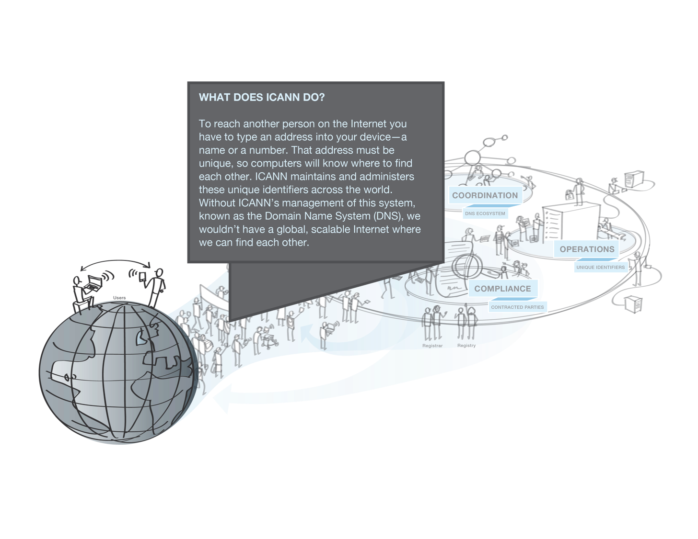
ICANN coordinates the Domain Name System (DNS)
Management and administration of unique identifiers
that let us reach another person, website, or information
Notes:
ICANN coordinates the addresses and unique identifiers that allow for the Internet to be a single, interoperable and growing network. ICANN maintains and administers the Domain Name System (also called the DNS), which we use to navigate to where we want to go – whether to find a website, another person, or specific information.

Slide 4
Multistakeholder Policy Making
ICANN Board Approval
Business, including
Domain Name Businesses
ICANN Policy Making Process
Governments and
IGOs
Civil Society
Organizations and Individuals
End Users (all Categories)
Address and Numbering Organizations
Technical, Network, and Security Experts
Notes:
Another reason the Internet expands so quickly is because of the Multi Stakeholder Model. Under this model, many participants -- including governments, businesses, academics, technical experts, individual Internet users, non-governmental organizations and other segments of society – come together to set the policies for the Internet’s development, including for addresses.

Slide 5
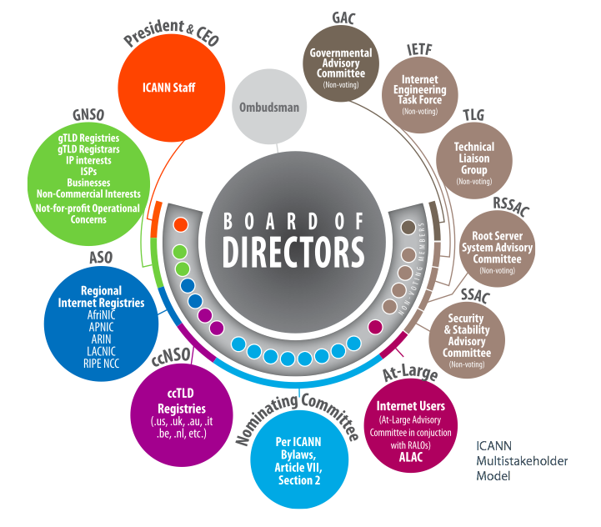
Multistakeholder Model
Notes:
Within the ICANN Multistakeholder model, private sector interests are mostly represented by the non-contracted party house within the Generic Names Supporting Organization, and specifically the Commercial Stakeholder group and its three constituencies: the Commercial and Business Users Constituency, the Intellectual Property Constituency, and the Internet Service Providers and Connectivity Providers Constituency.

Slide 6
Global
Scalable
Interoperable
Notes:
The work of ICANN helps the Internet expand in a global, scalable and interoperable way.

Slide 7
The Boston Consulting Group report on E-Friction
Notes:
In 2014 ICANN Commissioned a report to determine how much the global, interoperable Internet contributes to economic and business success.

Slide 8

Greasing the Wheels of the Internet Economy
ICANN Commissioned the Boston Consulting Group (BCG) to conduct this study in 2014
Digitally-driven economic growth continues to be one of the few bright spots in a sluggish global economy
Notes:
The report introduced the concept of “e-friction”. This is broadly defined as barriers to Internet access, whether within a country or across national borders. The results were released at the World Economic Forum in January.

Slide 9

Which Wheels to Grease?
Update to the 2014 study
This update expands on the analysis of e-friction by looking at its major causes and by defining clusters of countries that face similar challenges and can work together towards similar solutions.
Notes:
The five major causes of e-friction identified in the 2015 update are wealth, population density, the urban-rural population mix, literacy, and English-language skills. Wealth is an important factor, but it does not explain e-friction on its own. The common causes of friction suggest high-potential solutions.

Slide 10
Main Sources of E-Friction
  Industry
  Weighted 1/6
  Frictions holding back companies from adopting the Internet
  Frictions reducing opportunities to access the Internet
Infrastructure
Weighted 3/6
  Individual
  Weighted 1/6
  Information
  Weighted 1/6
  Frictions deterring consumers from online activity
  Frictions related to the availability of content
Notes:
The four categories of friction BCG chose to study are:
Infrastructure – This counts for one half and includes factors like broadband penetration, connection speeds, IPv6 deployment, Internet Exchange Points, etc.
Industry – Things like ease of starting a business, access to ICT skills, access to financing, strong business legal framework, Intellectual property, Enforceable contracts, etc
Individual – This includes trust in online payment systems, online financial services, literacy, percentage of people online, among other factors
Information – This score covers local content, local domain (website) registrations, freedom of the press, freedom of access to official data (e.g. e-government programs)

Slide 11
E-Friction Index includes 65 countries
Covering ca. 92% of global economy and ca. 81% of global population
Country | e-Friction score | Infra-structure | Industry | Individual | Infor-mation
1. Sweden | 14 | 15 | 15 | 10 | 16
2. Finland | 17 | 21 | 16 | 8 | 14
3. Denmark | 21 | 21 | 37 | 15 | 11
4. Switzerland | 21 | 22 | 21 | 13 | 27
5. Hong Kong | 21 | 18 | 9 | 22 | 43
6. United States | 22 | 23 | 26 | 28 | 11
7. Iceland | 22 | 17 | 34 | 36 | 14
8. Norway | 23 | 25 | 26 | 14 | 20
9. Netherlands | 25 | 28 | 21 | 13 | 30
10. Canada | 25 | 32 | 28 | 13 | 15
11. Germany | 26 | 28 | 35 | 17 | 18
12. United Kingdom | 28 | 29 | 27 | 29 | 25
13. Austria | 29 | 27 | 40 | 25 | 29
14. Australia | 30 | 38 | 26 | 27 | 15
15. Singapore | 31 | 30 | 9 | 25 | 66
16. Belgium | 32 | 34 | 27 | 23 | 42
17. New Zealand | 33 | 42 | 30 | 27 | 17
18. Ireland | 34 | 34 | 41 | 36 | 24
19. France | 34 | 38 | 33 | 26 | 32
20. Estonia | 35 | 35 | 47 | 43 | 19
21. Japan | 39 | 33 | 32 | 50 | 53
22. Israel | 39 | 37 | 39 | 39 | 48
23. Qatar | 40 | 51 | 19 | 23 | 44
24. UAE | 41 | 45 | 25 | 33 | 49
25. Korea, Rep. | 41 | 28 | 45 | 47 | 69
26. Slovenia | 44 | 34 | 58 | 56 | 47
27. Bahrain | 44 | 41 | 42 | 36 | 60
28. Malaysia | 44 | 52 | 28 | 42 | 40
29. Poland | 45 | 45 | 65 | 42 | 31
30. Portugal | 45 | 43 | 43 | 49 | 51
31. Romania | 46 | 29 | 81 | 70 | 35
32. Czech Republic | 46 | 38 | 62 | 47 | 54
Country | e-Friction score | Infra-structure | Industry | Individual | Infor-mation
33. Spain | 47 | 46 | 52 | 43 | 51
34. Panama | 48 | 42 | 39 | 57 | 65
35. Hungary | 48 | 47 | 62 | 59 | 30
36. Italy | 49 | 42 | 64 | 62 | 41
37. Bulgaria | 53 | 39 | 71 | 76 | 55
38. Greece | 53 | 49 | 65 | 65 | 43
39. Ukraine | 54 | 45 | 77 | 74 | 33
40. Kuwait | 56 | 55 | 73 | 53 | 47
41. Chile | 57 | 60 | 44 | 55 | 61
42. Jordan | 57 | 53 | 48 | 67 | 69
43. Russia | 57 | 49 | 73 | 59 | 66
44. Saudi Arabia | 58 | 54 | 36 | 54 | 92
45. Turkey | 58 | 52 | 60 | 59 | 76
46. Kazakhstan | 64 | 58 | 70 | 61 | 76
47. Philippines | 64 | 71 | 61 | 65 | 43
48. Thailand | 64 | 61 | 59 | 63 | 81
49. Argentina | 67 | 61 | 91 | 76 | 53
50. South Africa | 67 | 75 | 50 | 63 | 68
51. Mexico | 68 | 66 | 69 | 79 | 59
52. Brazil | 69 | 67 | 71 | 71 | 68
53. China | 69 | 73 | 56 | 66 | 75
54. Morocco | 70 | 72 | 58 | 76 | 73
55. Venezuela | 71 | 66 | 88 | 80 | 58
56. Colombia | 71 | 72 | 76 | 75 | 61
57. Kenya | 71 | 80 | 71 | 68 | 51
58. India | 73 | 79 | 52 | 71 | 77
59. Indonesia | 74 | 78 | 56 | 75 | 78
60. Peru | 75 | 79 | 71 | 84 | 55
61. Vietnam | 75 | 69 | 73 | 82 | 87
62. Bangladesh | 75 | 74 | 86 | 90 | 53
63. Egypt | 76 | 78 | 77 | 92 | 55
64. Pakistan | 82 | 79 | 72 | 89 | 92
65. Nigeria | 82 | 89 | 77 | 86 | 59
Note: Best e-Friction available is 0, worst is 100
Top
Bottom - Quintiles
Notes:
The result of the calculations is a country index that calculates the level of friction in each category and adds them together.
Country scores are based on a combination of the four factors. In this chart, the larger the bar, the greater the friction.
The countries chosen were a factor of which countries had available data.
Open, trading economies and advanced world economies with low infrastructure friction do very well in the survey.

Slide 12
Significant Positive Economic Impact
> 3.2 B unconnected people
8%
R²=0.60
United Kingdom
2013 digital economy¹
as % of GDP (est.)
6%
Denmark
Sweden
Top
quintile e-Friction
Korea, Rep.
Japan
Netherlands
4%
United States
Hong Kong
Czech Republic
Poland
Belgium
Australia
Equivalent to
2.5 pts of the
overall economy
Greece
Canada
South Africa
Italy
France
Germany
2%
Brazil
Mexico
Saudi Arabia
Egypt
Argentina
Russia
Bottom quintile e-Friction
India
China
Turkey
Indonesia
0%
80
70
60
50
40
30
20
10
0
e-Friction score, 2013
Notes:
BCG also pioneered studies on how much of a nation’s GDP comes from the digital economy.
Low e-friction correlates with high e-GDP. The difference between countries in the top quintile and lowest quintile of the index is 2.5% of GDP.

Slide 13
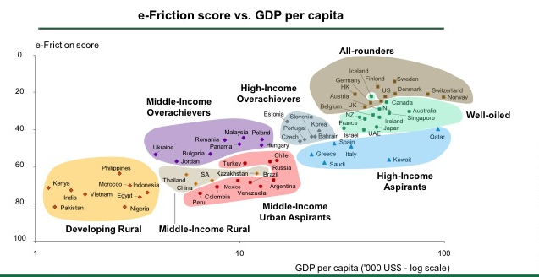
An Analysis of E-Friction & Per Capita GDP Reveals 8 Clusters with Similar Issues
Notes:
All-rounders
Well-oiled nations
High-income overachievers
High-income aspirants
Middle-income overachievers
Middle-income rural
Middle-income urban aspirants
Developing rural

Slide 14

E-Friction and the Private Sector

Slide 15











The Internet and SMEs
Past three years
Cumulative revenue growth
%
Average
Heavy
web use
+18%
+7%
Med / light
web use
+11%
Higher
e-Friction
Lower
e-Friction
Notes:
The BCG study also surveyed several thousand Small and Medium Enterprises (SMEs) in the countries reviewed.
SMEs in low e-friction countries who embrace e-solutions can increase revenue growth by 7 %.
These SMEs are 50% more likely to be exporters of goods or services and 63% more likely to source inputs internationally.

Slide 16
E-Friction and the Private Sector
Today world trade represents about 30% of global GDP, up from 20% form the early days of the Internet.
The experience of SMEs seeking to do more online illustrates how the Internet is shaping the future of world trade and contributing to its growth.

Slide 17
E-Friction and the Private Sector
The BCG study surveyed several thousand Small and Medium Enterprises (SMEs) in the countries reviewed.
SMEs in low e-friction countries who embrace e-solutions can increase revenue growth by 7 %.

Slide 18


The Internet helps SMEs extend their geographical reach
Geographical reach of sales
Geographical reach of purchases
% of SMEs
+6%
% of SMEs
+5%
96%
97%
90%
93%
+14%
+17%
81%
77%
71%
+23%
65%
+34%
58%
53%
48%
40%
+63%
+49%
Heavy
web use
18%
Heavy
web use
22%
12%
Med/light
web use
13%
Med/light
web use
Neighbour-
hood
City
Region
Country
World
Neighbour-
hood
City
Region
Country
World
Source: BCG SME Internet e-Friction survey 2013
Notes:
SMEs in low-friction economies are 50% more likely to be exporters of goods or services and 63% more likely to source inputs internationally.

Slide 19
Reducing e-Friction essential to help SMEs go further online
SMEs' view on e-Frictions within their country
  Infrastructure
Problem
Neutral
No problem
Cost of access to tools to be online
32%
Regulations to operate online
31%
Quality of internet connection
28%
Cost of internet access
27%
Choice of internet providers
27%
Reliability of Internet service providers
24%
  Industry
Process to start a new business
41%
Supportive regulations to encourage online sales
37%
Availability of industry support group
37%
Availability of market funding for online offer
36%
Hiring of managers for online activities
35%
Offline infrastructure to support online sales
34%
Reliability of intellectual property rights online
33%
Company’s fund to further develop the online offer
30%
Staff preparedness for online activities
30%
Willingness to buy online due to return policy
30%
Belief in Internet’s contribution to the business
25%
Employees access to computers
23%
  Individuals
Belief in safety of personal data online
51%
Consumer trust in online payment systems
38%
Safety to store our data or sell online
31%
Customers ownership of tools to be online
30%
Customers’ skills to be online
28%
Customers interest to interact via website
23%
  Infor-mation
Cost to set up and maintain a website
30%
Complexity to set up and maintain a website
29%
Choice of online tools providers
27%
Cost to obtain a website domain
26%
Difficulty to obtain a website domain
22%

Slide 20
Where to Find the Reports?
http://goo.gl/lmBDtr
http://goo.gl/91NkW8

Slide 21








Engage with ICANN
Thank You and Questions
twitter.com/icann
twitter.com/icann4biz
gplus.to/icann
facebook.com/icannorg
weibo.com/ICANNorg
linkedin.com/company/icann
flickr.com/photos/icann
youtube.com/user/icannnews
slideshare.net/icannpresentations

