Slide 1
Manufacturing Industries in Africa: The Future Opportunities
10th AfiCTA Summit

Slide 2
Background Global Dynamics: A Pandemic, a trade war and a real war
Covid-19 repercussions
Disruption of supply chains
How to face future similar pandemics or other disastrous situations
Health care and medical supplies sufficiency is a matter of national security
A technology centric trade war
Redistribution of supply chain and manufacturing roles and geographies
Regionalization rather than globalization
Ukranian war impact of on world economies, in particular African countries
Agriculture and food supply sufficiency issues
Oil, gas and Energy
World economies are suffering !

Slide 3
Background (Cont.) Global Dynamics: Market Drivers
Digital transformation
Fueling several industries and digital infrastructure development
A new way if life and new ways of doing business
Industry 4.0 and Industry 5.0
Accelerated by the pandemic
Auto industry transformation: Two mega trends
Electric vehicles
Autonomous driving
New opportunities for new players
Industrialization of agriculture !
Precision agriculture, smart farming
Agri 4.0 is key to increase productivity and achieve self sufficiency.

Slide 4
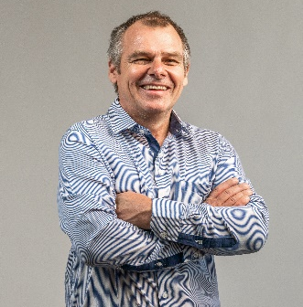
Panelists Mr. Paul Rowney
My key drivers are inclusion and ICT4Development toward unlocking the digital potential of the African continent. As co-founder and technical lead of the MyDigitalBridge foundation I was instrumental in an early trial of TVWS in Namibia. More recently I was the in-country technical lead for the South African USTDA Itaba TV White Space Pilot project. I have supported local and global NGO’s and IGOs in connectivity for development, engaged regulators, internet service providers, and companies on last mile connectivity and financial inclusion. I am the current chairperson of the Namibian e-Money forum, founding director of the ICT Professionals Association of Namibia, former advisory council member to the Alliance 4 Affordable Internet (www.a4ai.org), deputy president of the Africa ICT Alliance (www.aficata.org), advisory board member of the ISOC Namibia chapter, and former MAG member of the UN Internet Governance Forum. Through business and voluntary engagement, I have been fortunate to garner a global glimpse of the challenge ahead, that of bringing equitable opportunity to all in this new digital age.

Slide 5
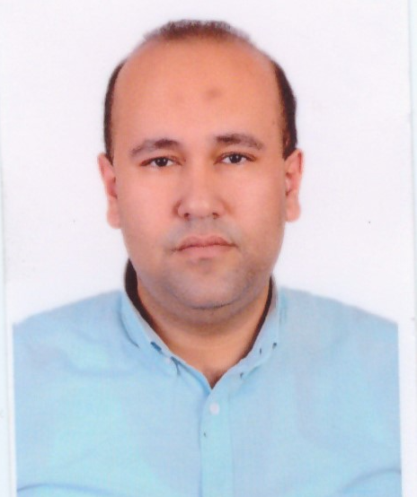
Panelists Eng. Mostafa El-Wakeel
Mostafa Elwakeel (BioBusiness Founder) is expert in medical devices development, Electronics, Industrial Design, Circuits Design, Medical Equipment Standards and Safety with more than 15 years of experience. he obtained a B.Sc. in Biomedical Engineering from the University of Cairo 2006. Biomedical engineering is a domain with a lot of innovation; however, the healthcare industry as a whole is still lagging behind from other Fields like IT and communication industries and is facing a major issue related to the high costs of medical equipment. Mostafa has been decided to address those issues by founding BioBusiness in 2009.

Slide 6
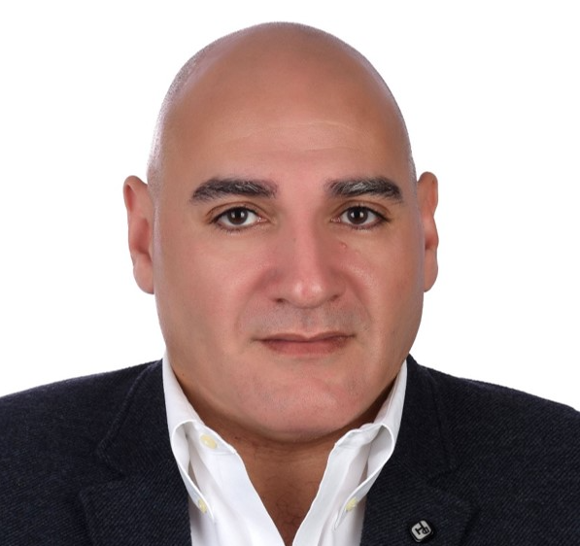
Panelists Eng. Hicham Arafa
Eng.Hicham Arafa brings 25 years of Engineering Management experience, where he has led and contributed to the building of many leading technology companies in Egypt. Hicham Has been the Chief Operations Officer and Partner for Brightskies since the year 2017, where he has successfully steered the growth of the company from 40 engineers to 200+ engineers in 2021.
Prior to joining Brightskies, Arafa was the R&D director and Deputy General Manager for Valeo Egypt, where he spent 6 years growing Valeo’s engineering capacity and making it the biggest software development center in Egypt and in the region, employing more than 2000 Engineers and serving all of Valeo’s Business Groups under one roof.
Prior to his role at Valeo, Arafa worked with Intel Corporation as the Business Development Manager for Egypt, Levant and North Africa, where he opened multiple offices for Intel in Algeria, Morocco and Libya. Prior to that Hicham served as the Strategic Initiatives Manager for Intel’s Platform Definition Center based in Cairo, which was one of the four unique technical centers that Intel opened worldwide to define, plan and develop specific products for the Middle East, Turkey and Africa region.
Arafa started off his career at Intel in the USA in 1999, where he held numerous positions including Validation Architect at the Enterprise Server Group, the Embedded Intel Architecture Division, when he finally returned to Egypt in 2003 to work for the Sales and Marketing Group.
He was born in Cairo 1971 and received his B.Sc in Electrical Communications from Cairo University in 1994, his MSEE in high performance computing from West Virginia University in 1998, and his MBA in Technology Management from the W.P.Carey school of business at Arizona State University in 2003.
Brightskies is a leading engineering service company in Alexandria working in the area of High Performance Computing, Automotive Embedded System and Enterprise Solutions development.

Slide 7
Main Questions For Panelists
Given the significant transformation of the auto industry, can African countries develop into real palyers in the new auto industry ?
If yes, where can we penetrate ?
And what would be the major challenges facing our countries ?
Is there an opportunity for African countries in terms of healthcare and medical equipment industries ?
What can we and what is the major challenges
Status of the ICT ecosystem for local value add to manufacturing industries, agri 4.0 and other domains in Africa

