Slide 1


ELECTRONIC WASTE
ENG. AHMED KAMAL ABDEL MONEIM
Executive Director
(FEI Technical &
Climate change Advisor)

Slide 2

WHO ARE WE?
www.eco-fei.org
Eco.fei
The Environmental Compliance Office and Sustainable Development
Established within the Federation of Egyptian industries in 2001. ECO-SD provides consultancy services to the industry sector in the fie of environmental-compatibility, Sustainable Development Goals, energy conservation and Renewable Energy in order to raise the efficiency of national industry.

Slide 3




Digital waste management can help create a Sustainable and Circular economy
CIVIL SOCIETY
GOVERNMENTS:
-Regulation and Policy
- Enforcement
-Education and Awareness
-Raise consumer awareness
-Advocate for stronger regulations
-Improved recycling infrastructure
-increase in transparency and accountability in the electronics industry.
ACADEMIA
TECHNICAL COMMUNITY
Research to develop innovative technologies and safe handling, recycling, and recovery of valuable materials from digital waste.
Collaboration between the technical community, academia, and governments can lead to the development of sustainable product design standards.

Slide 4
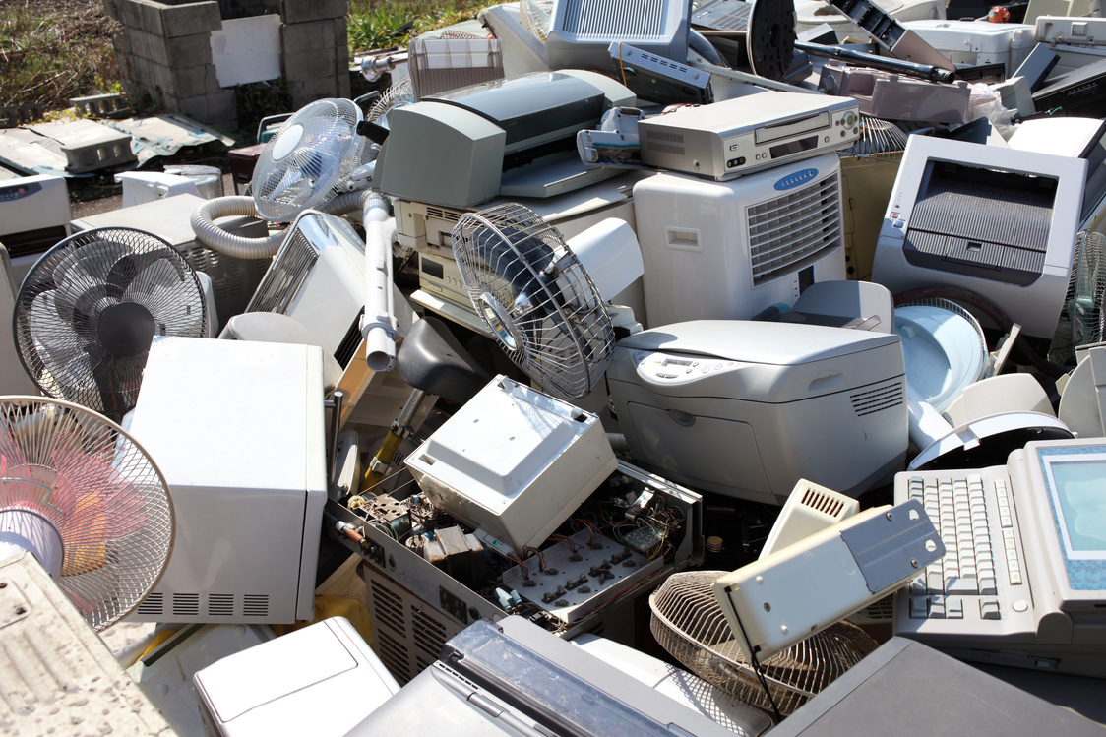

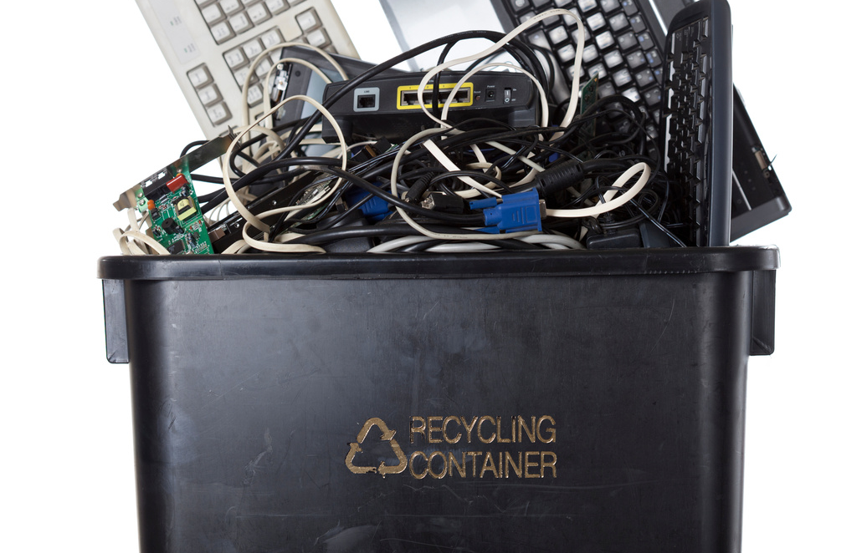


To effectively manage E-waste and minimize its environmental impact, it is essential to follow some important guidelines
REDUCE AND MINIMIZE:
REUSE AND REPURPOSE:
RECYCLE RESPONSIBLY:
RAISE AWARENESS AND ADVOCATE:
Adopt sustainable consumption, avoid impulse buying, and extend product lifespan to reduce e-waste
Donate or sell old electronic devices to redistribute them, or upgrade them to extend their lifespan.
locate collection points, and erase personal data before recycling to protect privacy and prevent misuse.
Educate others and support policy changes to promote responsible e-waste management.

Slide 5
Ripple Effects of Continuous Reliance on Used and Old Equipment:
Technological Inefficiency:
LIMITED ACCESS TO NEWER INNOVATIONS
INCREASED MAINTENANCE AND REPAIR COSTS
ENVIRONMENTAL CONCERNS:
Outdated technology can lead to inefficiencies in education, healthcare, and business.
Old equipment hinders productivity, competitiveness, and technology use.
Older equipment requires more frequent maintenance and repairs, leading to financial burdens.
Improper disposal of old equipment can lead to environmental and health risks.

Slide 6
Cushioning the Effects of Banning Importation of Old/Used Gadgets
PROMOTE LOCAL MANUFACTURING AND ASSEMBLY:
SUPPORT SUSTAINABLE TRADE PRACTICES
FOSTER PARTNERSHIPS AND TECHNOLOGY TRANSFER:
INVEST IN E-WASTE MANAGEMENT INFRASTRUCTURE
Local manufacturing and assembly capabilities can lead to more affordable devices.
Implement policies to promote sustainable trade practices.
Facilitate partnerships between developed and African nations to accelerate technology adoption.
Improve e-waste management infrastructure to reduce environmental and health risks.

Slide 7


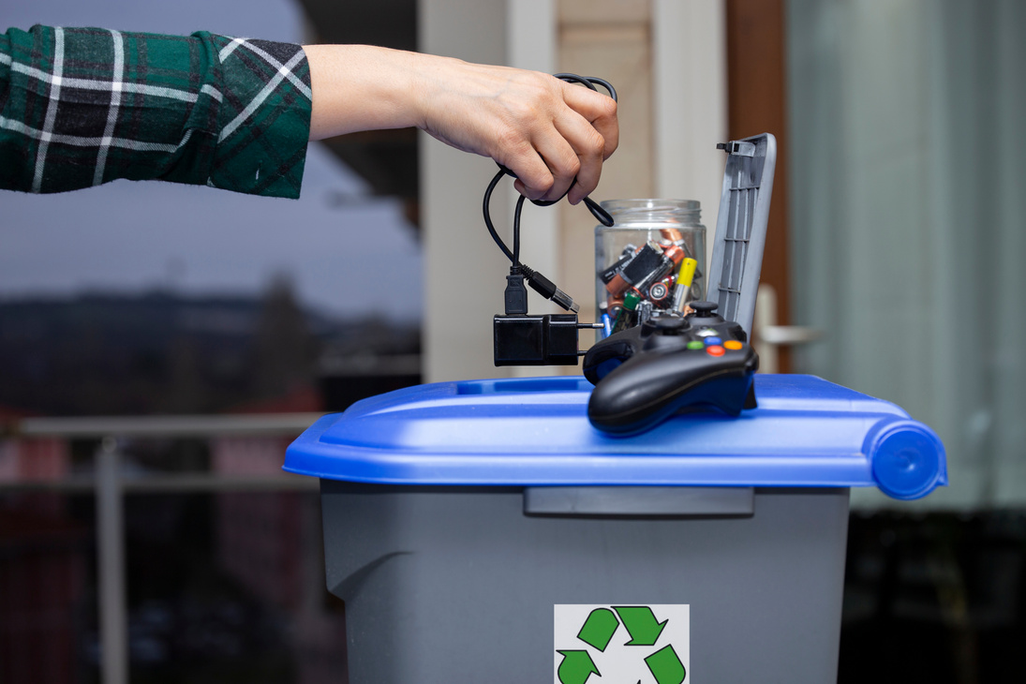
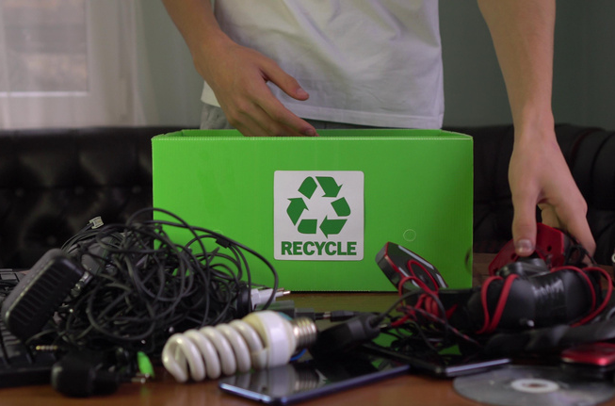
Multi-faceted approach needed to consider digital waste's impact on sustainability. Here are some key strategies:
Incorporate Environmental Considerations in Product Design
Promote Transparency and Reporting:
Foster Collaboration and Partnerships:
-Eco-Design Principles
-Extended Producer Responsibility (EPR)
-Certification and Standards
Should be implemented to promote sustainable design
Corporate Sustainability Reporting and Regulatory Requirements should be implemented to ensure transparency in digital waste management practices.
Multi-Stakeholder Collaboration and Public-Private Partnerships can promote dialogue, knowledge sharing, and collective solutions to address digital waste and sustainability challenges.

Slide 8
Multi-faceted approach needed to consider digital waste's impact on sustainability. Here are some key strategies:
Policy and Regulatory Measures:
Public Awareness and Education:
-Establish comprehensive e-waste management legislation -Provide economic incentives to encourage sustainable practices
- Foster international cooperation to address global digital waste challenges.
Awareness campaigns and education and research can help build a knowledgeable workforce and drive innovation in sustainable digital practices.

Slide 9

Government standards can reduce the carbon footprint of the Internet.
Here are some key ways in which they can contribute:
ENERGY EFFICIENCY STANDARDS:
RESEARCH AND DEVELOPMENT FUNDING:
Governments can set energy efficiency targets and introduce labeling programs to empower consumers
Allocate Funding: Governments can fund innovative solutions to reduce Internet carbon footprint.
RENEWABLE ENERGY ADOPTION:
E-WASTE MANAGEMENT AND CIRCULAR ECONOMY:
Governments can implement policies to incentivize the use of renewable energy sources, and support the development of power purchase
Implement e-waste and EPR legislation to reduce environmental impact and promote sustainable product design

Slide 10

MANAGING WASTE IN A CIRCULAR ECONOMY
PROMOTE REUSE AND REPAIR:
EXTENDED PRODUCER RESPONSIBILITY (EPR):
EPR programs encourage producers to design products for easier recycling and recovery.
Governments can support repair initiatives and develop reuse markets to encourage consumers to repair and extend the lifespan of electronic devices.

