Slide 1


Fighting Disinformation
as a Prominent Cybersecurity Challenge
Doctor Mafuwafuwane - Practice Manager: Security Solutions & Strategy, IITPSA SIGCyber – Vice-Chairperson

Slide 2
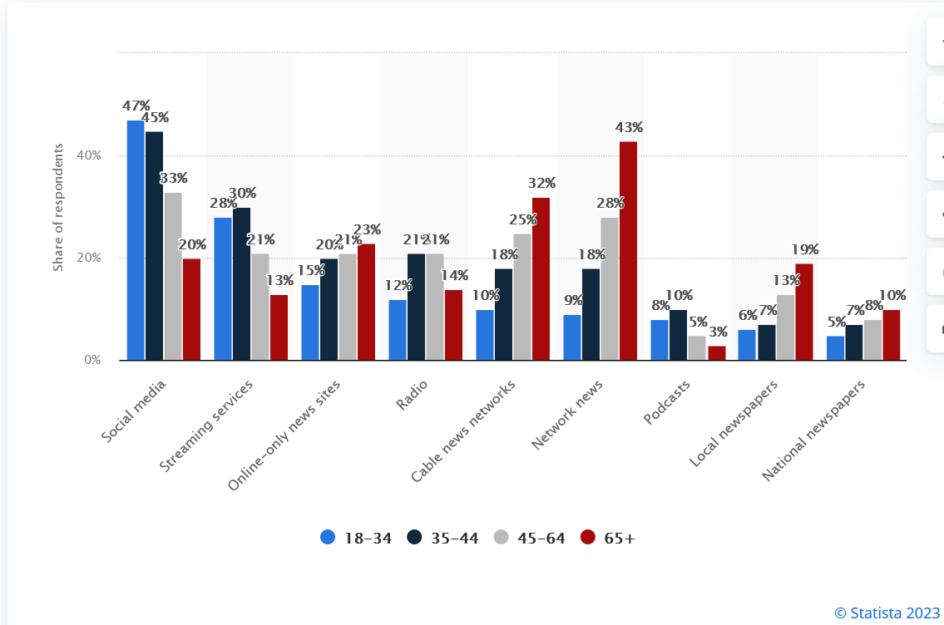
Where People Get Online News
Most popular platforms for daily news consumption in the United States as of August 2022, by age group
Social media was by far the most popular news platform among 18 to 34-year-olds in the United States, with 47 percent of respondents to a survey held in August 2022 saying that they used social networks for news on a daily basis.
Source: Statista2023

Slide 3
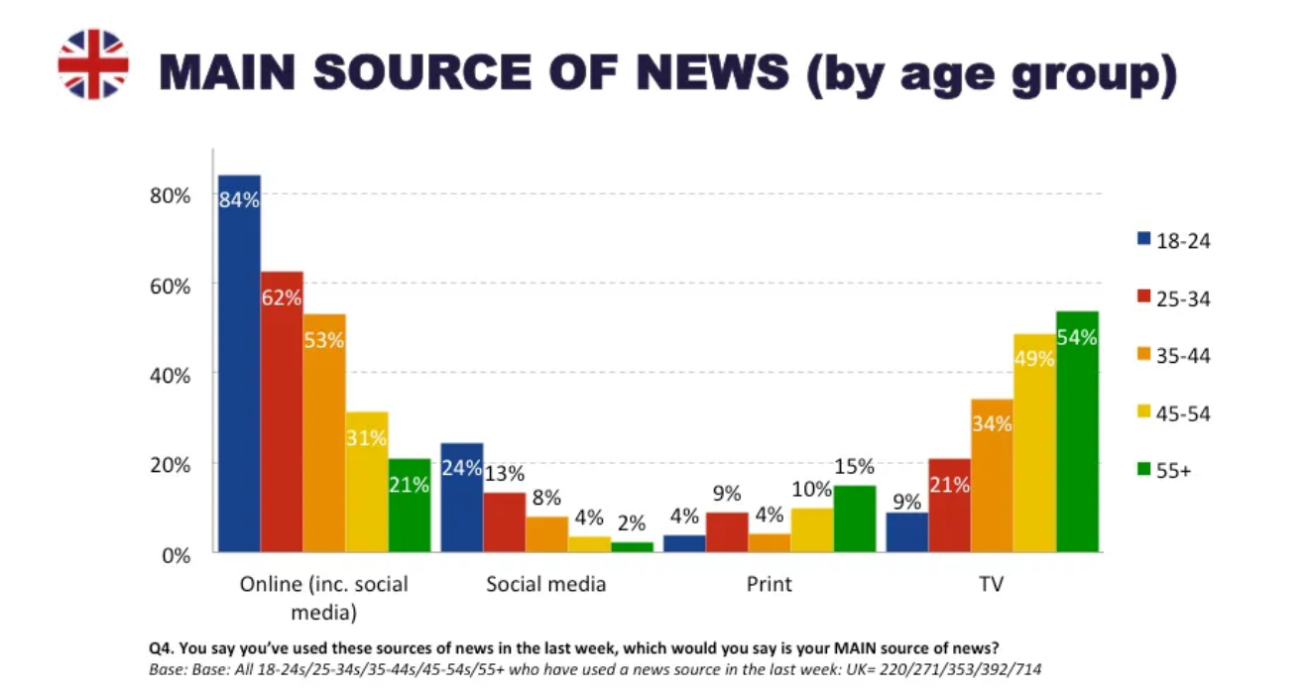
Generational differences in news use
The move from traditional sources of news like television and printed newspapers is particularly clear if we look at differences between age groups. There are very clear generational divides. Asked to identify their main source of news, online comes out number one in every age group under 45 — and for those under 25, social media are by now more popular than television.
Source: Reuters Institute for the study of Journalism

Slide 4
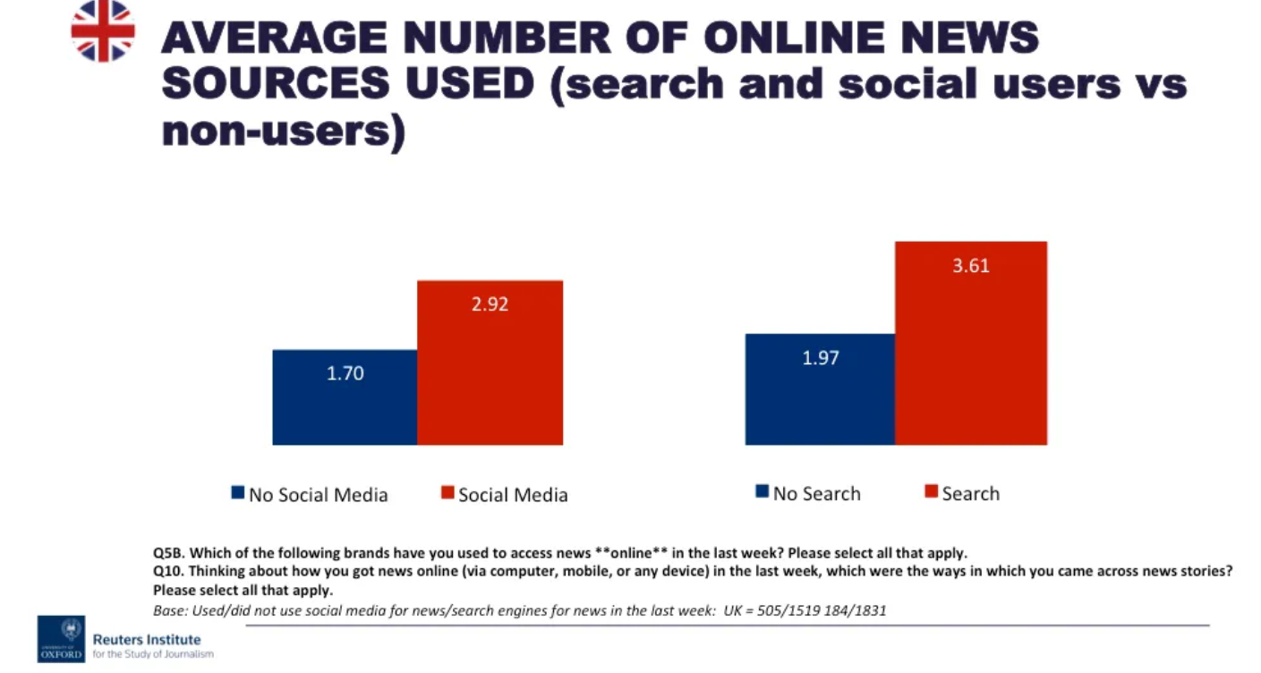
How do people find their news?
47% still say they go directly to the websites of broadcasters or newspapers for their news, but online, people increasingly find news via the various search (20%) and social media (25%) services offered by US-based platform companies like Google and Facebook. These have become integral to how people find and access news all over the world, including in the UK.
Source: Reuters Institute for the study of Journalism

Slide 5

What is the problem?
There are new difficulties in the digital age in determining whether information is accurate and trustworthy
The description ‘fake news’ does not mean there is such a category as ‘true’ news.
All news is a selection and written to suit a particular audience for a specific purpose.
The speed with which technology and young people’s online activity change makes it challenging to keep up-to-date with recent developments.
Even professional development programmes can go rapidly out-of-date.
Modern journalists must be adept at fact-checking, source verification, and critical analysis.

Slide 6

Disinformation Solution
Individuals can protect themselves from false news and disinformation by following diverse people and perspectives.
It is vital for schools to provide students with a solid education on media and information literacy as part of the curriculum.
Community Leaders must be well-trained in the subject to empower the community with necessary competencies to critically understand and assess information reported by all forms of media
Keeping staff up to date with new developments in information and communication technology
Training them in strategies for handling propaganda, misinformation and fake news
Notes:
In addition to these sorts of developments, there are a number of other initiatives a school can take to meet the challenges of the rapidly changing world of online propaganda, misinformation and fake news. These include:
Special days or events in school on the subject of propaganda, misinformation or fake news as a way of overcoming the problems of an over-crowded formal curriculum
Peer education initiatives in which older students instruct and counsel younger students in the safe handling of information they access in the media
Partnerships with outside professionals or companies with expertise in this area, e.g., journalists, IT companies, universities
Virtual links with schools in other regions or countries enabling students to get a different perspective on news and current affairs
Recruiting parents with expertise in information and communication technology to help with school policy development or work alongside teaching staff to enrich student learning.

Slide 7
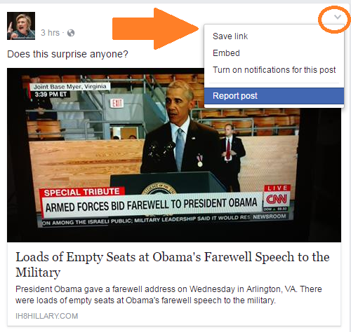
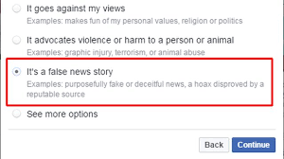
Sharing is not caring, Report disinformation
When you encounter a piece of disinformation, the most important thing you can do is to stop it from spreading.
If you see disinformation on Facebook, don’t share, comment on, or react to it. If you’re on Twitter, resist the temptation to retweet, quote tweet, or share a screenshot.
If you encounter disinformation on social media, flag it for the social media platform where you see it.
Social platforms all give users the power to flag content that violates their guidelines, including Facebook, Twitter, Instagram, and TikTok.

Slide 8

Disinformation Free Solutions
Bad News
This tool intended to build user understanding of the techniques involved in the dissemination of disinformation. This game exposes players to fake news tactics used against them by putting them in the position of a news baron for fake news. Players win by publishing headlines that attract the most followers.
Bot Sentinel
Bot Sentinel is a free platform developed to detect and track trollbots and untrustworthy Twitter accounts. Bot Sentinel uses machine learning and artificial intelligence to study Twitter accounts, to classify them as trustworthy or untrustworthy, and to identify bots. It then stores those accounts in a database to track
Checkology
The News Literacy Project is a media literacy curriculum with both online and offline components, focused on teaching students to read and interpret the news.
YouTube Data Viewer - Citizen Evidence Lab
The YouTube Data Viewer is a web-based video verification tool offered through The Citizen Evidence Lab, created by Amnesty International. Users input a YouTube URL, and the tool outputs information about the video that is helpful in verifying a video. This includes upload time and thumbnails that can be used for reverse image searching.

Slide 9

Thank You
Enhance business agility by weaving security into your DNA

