Slide 1
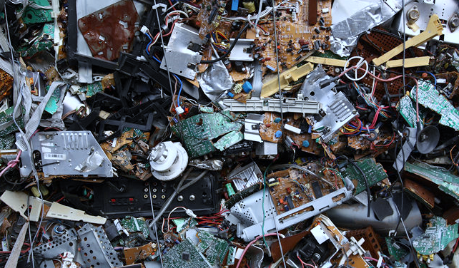

A Review on E-waste Management & Recycling challenges
Prepared by:
Dr. Yasmin El-Sayed El-Sharkawy

Slide 2
Outline
E-Waste Definition & categories
The main problem
Important facts
Economy
Digital transformation
Global statistics
Some statistics from the current market
Environmental safety
Product Selection Criteria
Electronic Waste lifecycle
Success factors

Slide 3








E-Waste Definition and Categories
Definition
1
Temperature Exchange Equipment
(refrigerators, freezers, air conditioners, heat pumps)
According to the OECD, e-waste is ‘‘any appliance using an electric power supply that has reached its end-of life’’.
2
Screens
(televisions, monitors, laptops, notebooks, and tablets)
3
Lamps
D
(fluorescent lamps, high intensity discharge lamps, and LED lamps.)
4
Large Equipment
(washing machines, clothes dryers, dish-washing machines, electric stoves, large printing machines, copying equipment, and photovoltaic panels.)
5
Small Equipment
(vacuum cleaners, microwaves, ventilation equipment, toasters, electric kettles, electric shavers, scales, calculators, radio sets, video cameras, electrical and electronic toys, small electrical and electronic tools, small medical devices, small monitoring and control instruments.)
C
Categories
6
Small IT
(mobile phones, Global Positioning Systems (GPS), pocket calculators, routers, personal computers, printers, telephones.)

Slide 4

The Main Problem
Huge cost to Health Sector
Waste of country resources
Environmental pollution

Slide 5




Important Facts
Problem of logistics & location
E-Waste recycling isn’t profitable
Collection point
Informal Sector

Slide 6


Objectives
01
02
03
Economy
Digital Transformation
Environmental Safety

Slide 7






01 Economy
Refurbishment
=
Job Creation
Dismantling
E-waste recycling creates new jobs for professional recyclers
01
=
9.4 Billion Euros
Urban Mining
Precious metals; gold, silver, and platinum can be extracted from old mobile phones and computers.
435 Kilotons
z
=
02
El-Sokkary Gold Mine
CBE gets 65 to 70 kg of gold per month in exchange for EGP 50m
03

Slide 8




Global Statistics
An average computer is made up of over 30 different minerals mined and extracted from the earth.
Some of these minerals are silica, iron, aluminum, copper, lead, zinc, nickel, tin, selenium, manganese,
arsenic, and cadmium - all non-renewable resources in our life time.
The metal concentrations of Au, Ag, and Pd in
ICT devices often exceed the concentrations found
in natural ores by up to 50 times
80-85% of all electronic products are discarded in landfills or incinerators releasing
toxins into the air and soil.
It takes 245 kg of fossil fuels, 22 kgs of chemicals, and 1500 liters of water to manufacture one desktop
computer.
30 different minerals
Manufacturing one PC
Landfill Percentage
Metals in ICT Devices

Slide 9
Some Facts from Existing Market
One ton of recycled cell phones can generate up to 230 grams of gold
More than 80% of a mobile phone can be recycled 40% plastics, 20% trace materials, 20% comprise material
Current mass of phones being recycled is only about 0.001-0.003% of the total weight of waste electronic equipment each year.

Slide 10




02
Digital Transformation
01
02
03
03
04
Financial Inclusion
Social Impacts
Education
Imports

Slide 11






03 Environmental Safety
Lead (PB)
Beryllium (Be)
o Damage to central and peripheral nervous systems, blood systems and kidney damage.
o Affects brain development of children.
o Carcinogenic (lung cancer)
o Inhalation of fumes and dust. Causes chronic beryllium disease or beryllicosis.
o Skin diseases such as warts.
Cadmium (CD)
Plastics including PVC
o Toxic irreversible effects on human health.
o Accumulates in kidney and liver.
o Causes neural damage.
o Teratogenic.
o Reproductive and developmental problems;
o Immune system damage;
o Interfere with regulatory hormones
Mercury (Hg)
Hexavalent chromium (Cr) VI
o Chronic damage to the brain.
o Respiratory and skin disorders due to bioaccumulation in fishes.
o Asthmatic bronchitis.
o DNA damage.

Slide 12
Product Selection Criteria
Availability of Infrastructure
Ease of Implementation
Experience
Volume of Waste
Hazardous Nature
ICT Equipment represent the highest percentage of WEEE with high rate of increase
Components of ICT equipment include hazardous material
7 Facilities in Egypt currently work on dismantling WEEE predominantly ICT equipment
Availability of NTRA regulator, nature of producers, no or limited local production
Voluntary schemes implemented by telecommunication companies

Slide 13
Electronic Waste Life Cycle
Take Back
Refurbishment
Metal Recovery
Sorting
Recycling
Re-Use
Manufacture
Dismantling
Re-Use

Slide 14
Success Factors
Clarity
There should be no ambiguity about what products are covered, who the producers are and what are their responsibilities. The objectives and targets should also be clear.
Clarity
Capacity
Investment in capacity to operate the EPR system. This includes human resources, IT systems and establishment of standards.
Awareness
Capacity
Transparency
EPR funds should be earmarked for financing the system. Producers and the public should be able to know the amounts collected and how they are spent. EPR is not a tax
Success Factors
Accountability
Accountability is needed to ensure that the system is achieving its objectives. The role of the external audit as well as the EPR committee is essential.
Consultation
Transparency
Consultation
Accountability
Stakeholder consultation prior to the establishment of the system as well as during implementation is crucial.
Awareness
Having a well designed system will be useless if the public are not engaged and are aware of how and where to dispose of their EoL products.

Slide 15
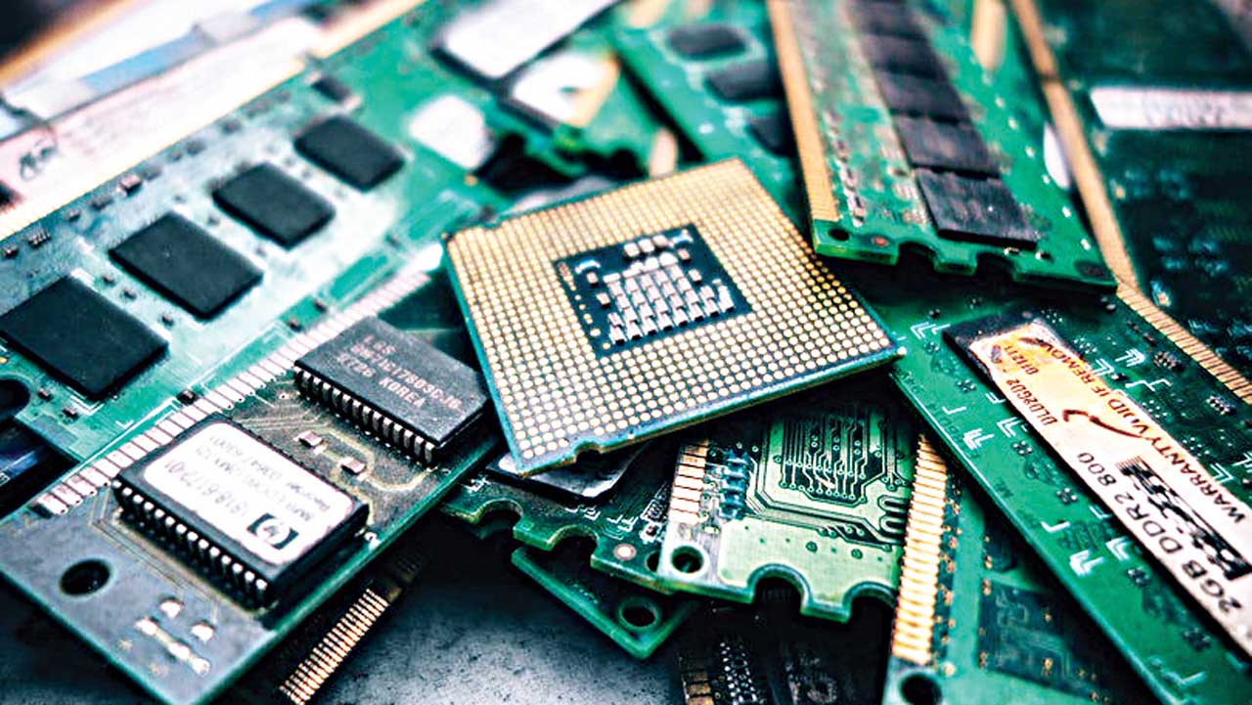
Thank you

