Slide 1
AfICTA Summit 2018 Making ICT Central to the Big 4 Agendas in Africa
8 October 2018
Nairobi, Kenya
Elizabeth Thomas-Raynaud
Director and Senior Policy Executive
ICC Digital Economy and BASIS
Notes:
Good morning and thank you for inviting me
Pleased that the connectivity, technology applications and services and user capabilities on each side of this exchange makes it possible to join you today.

Slide 2
Table of contents
International Chamber of Commerce
Role of business and SDGs
ICT and the global goals
ICC policy guidance
Key messages
Perspectives on the ITU

Slide 3

The International Chamber of Commerce
Why ICC engages in digital issues:
Develop and advocate policies that enable investment and the use of ICTs
Facilitate trade in the digital economy
Foster trust in digital environments
Encourage best practice
“ Granting Observer Status to ICC sends a powerful signal that the UN recognizes business as a vital partner.” ICC Honorary Chairman Sunil Bharti Mittal
Our mission
ICC creates solutions for economic growth to secure peace and prosperity for all.
Notes:
As the world’s first and largest business organization, ICC will leap into its 100th year in 2019.
Much has changed since 1919 from the products traded to the tools and services relied on by businesses of all sectors and sizes but the fundamental mission---to promote cross-border trade and investment and pursue solutions -
To secure Peace and Prosperity for ALL.
A partner to the United Nations for many years, …..recently granted Official Observer status to the UN General Assembly – recognising importance of the business sector …..especially in view of 2030 agenda.
AFICTA partners are actively engaged colleagues from the continent on digital economy topics ….enjoy partnerships with other regional groups, such as e-commerce Africa and through our national committees
ICC is home to the International Court of Arbitration – one of the world’s most-respected dispute resolution institutions. The Court’s Africa Commission benefits from the expertise of 24 Court members from 16 African countries and is Chaired by Madame Kamau of Kenya.

Slide 4

BUSINESS and the SDG agenda
Businesses of all sizes and sectors have an important role to play in the realization of the 2030 Development Agenda and the SDG targets by developing innovations, deploying infrastructure and delivering a wide range of services that support and catalyze sustainable development opportunity.
Business contributes through capacity building and education initiatives, promoting innovation, public-private research and development partnerships in collaboration with other stakeholders.
Visit www.iccwbo.org for more information on how ICC and its members support the SDGs.
ICC is amplifying the role of business in the UN Sustainable Development Agenda.
Through our global advocacy and UN Observer status we are able to demonstrate business as key partner in reaching the SDGs.
Notes:
ICC has been a long standing partner of the UN and agencies to help bring business perspectives into global policy discussions and deliberations.
ICC is very committed to supporting the realisation of the global goals – working to raise awareness among business of the goals and connect their activities to the annual review and evaluation
Also facilitating business participation and contributing perspective to develop capacity to achieve the goals collectively
ICC membership of all sizes and sectors and the benefits of ICT mean that business can play a role both locally, regionally and globally
.

Slide 5

Ict for societal benefit
ICT forms the backbone of today's digital economy and has a strong potential to fast forward economic growth and improve people's lives in fundamental ways in developed and developing countries.
Business can play an important role in making investments in ICT that can solve problems through basic ICT applications and emerging technology. Policymakers have an important role in understanding both the potential of ICTs and how to facilitate an enabling policy environment for investment.
Basic ICT is helping farmers in developing countries keep pace with accelerating demand for milk products that have been a force in improving quality of life and boosting rural economic growth.
Preserving large amounts of perishable items such as milk in tropical countries requires extensive processing and distribution planning.
Control systems provide intuitive automation and maintenance solutions that ensure a hygienic, efficient environment for processing and preserving milk’s health benefits.
Notes:
Opportunity
Because e-commerce allows traders to bypass traditional gatekeepers, it also has great potential for female economic empowerment, as female-led companies are more likely to be small and medium enterprises (SMEs). In China, though women account for only 25% of all entrepreneurs, they have founded 55% of new online businesses.
Efficiency
Digital technology is helping businesses predict and regulate their supply chains, providing faster and cheaper shipping routes, and reducing disruptions. Customs administrations are also applying digital tools to implement customs clearance systems to improve risk management.
Sustainability
Equipping traditional farm devices with mobile apps using real-time data can increase safety and decrease negative environmental impacts, for example by automated and targeted pesticide applications. This is leading to higher productivity and overall more sustainable and lower cost of production in agriculture, benefitting both producers and consumers.

Slide 6





Ict is a tool to leverage
To us ICT for sustainable development policymakers need to understand how ICT solutions apply and what types of policy approaches can help ensure the benefits are wide spread and empowering for local populations.
But how can this be done in practice…?
Business and other relevant stakeholders can work together with governments to ensure better understanding of the steps and policy approaches needed to ensure an enabling environment.
ICC brings businesses together to share private sector experience and expertise to develop guidance and encourage effective, globally-interoperable policy approaches.
Notes:
Governments can do more to maximize the impact digital technologies
The benefits don’t happen overnight. Ensuring digital trade fosters inclusive growth relies on an economy having a solid policy environment and effective digital strategy in place. As governments map out ways to foster the local benefits of digital trade, ICC offers some

Slide 7
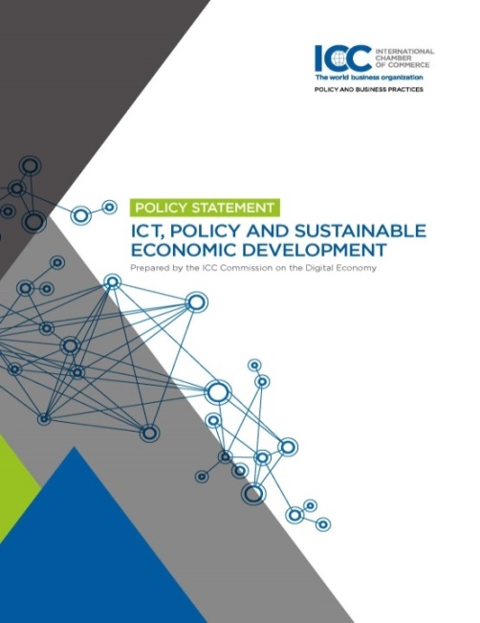
ICC policy GUIDANCE
The policy statement and annual updates:
creates awareness about the inter-related components of the ICT ecosystem.
highlights contributions business and other relevant stakeholders bring to policy-making efforts.
offers an impactful policy tool across global and local development agendas.
articulates business needs and the policy environment required to support sustainable investment in ICT.
develops capacity in governments and the business community on the approaches needed to support the ICT ecosystem and leverage technology for sustainable growth.

Slide 8
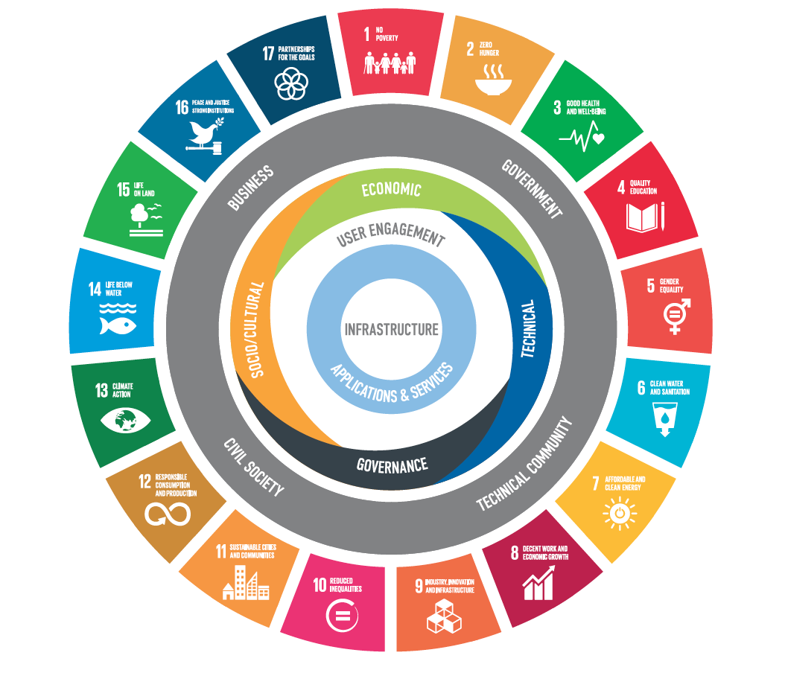
ICC KEY MESSAGES
ICT is an essential foundation for enabling the SDGs, but not sufficient without a policy environment that can enable its development and deployment appropriately.
ICC proposes a holistic framework to create awareness of the impact policies have on the infrastructure, applications, services and user-engagement layers of the ICT ecosystem.
All this equips policymakers with a framework to identify appropriate policy approaches to leverage ICT for realizing the SDGs.
Notes:
Take a holistic approach to developing policy frameworks – There is no one size fits all approach to nurturing the development gains of digital technologies but governments should start by being future-orientated. This means equipping
populations with the skills needed to innovate and leverage digital tools, promoting investment and market entry to attain greater coverage of networks and driving interoperability across policy and regulatory landscapes.
Remove artificial constraints and unjustified localisation measures – Creating artificial constraints to company global supply and value chain planning through data or server localisation restrictions not only increases the costs of doing business, but also diminishes the attractiveness of the location for investment or inclusion in such value chains. In some cases, local data storage regulations can lead to higher costs for the local companies – especially SMEs – that depend on technology such as cloud computing.
Avoid imposing custom duties on electronic transmissions at national borders – Electronic transmissions are typically time-sensitive and need to flow seamlessly across borders to be efficient. To stop these transmissions at borders to impose custom duties would unduly disrupt basic business processes that are inherent in electronic delivery.

Slide 9
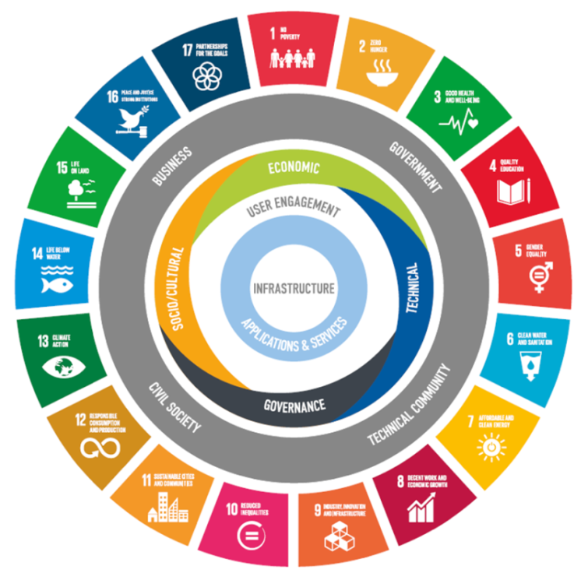
components needed to leverage ICT for sustainable economic development
The central circles : ICT ecosystem
infrastructure, applications and services, user engagement
The quadra-colour circle: policy issues
economic, technical, social/cultural, governance
The gray circle: multistakeholder approach
business, governance, technical community, civil society

Slide 10

ICT ECOSYTEM as a foundation
An interoperable, seamless ICT ecosystem is crucial to help populations reap the benefits of ICT and further development opportunity
For example a mobile phone based platform for money transfer and financial services can illustrate how the ecosystem works in practice.

Slide 11

Multistakeholder approaches for well-informed and purposeful policymaking
An example to illustrate the multistakeholder approach:
SDG 5 achieve gender equality and empower all women and girls
Governments can generate policies that are timely, scalable, and innovation enabling.
Business deploys Internet related infrastructures and delivers a wide range of ICT services. Business also encourages access through capacity building and education initiatives.
Civil society can advise on societal and cultural factors within social groups that may impact women’s access and use of ICT.
Technical community lends its expertise by advising on technical capabilities of infrastructure and technology.

Slide 12
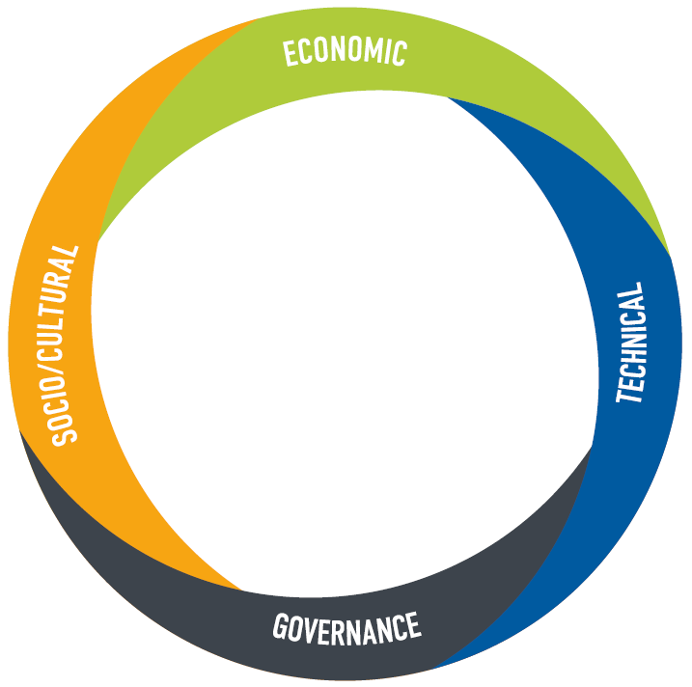
Effective policy approaches to support an enabling policy environment
Economic policy considerations:
Investment, data protection, cross border data flows
Social/cultural policy considerations:
ICT skills, access for disadvantaged groups, locally relevant
content, resources and tools
Technical policy considerations:
Infrastructure, spectrum allocation
Governance policy considerations:
Interoperability, public-private partnerships, institutional
capacity and cooperation

Slide 13

ICC VISION FOR ITU PP-18
The next ITU Plenipotentiary Conference (PP-18) will be held in Dubai (United Arab Emirates) between 29 October and 16 November.
The PP-18 will decide the future direction and priorities of the organization.
On occasion of this event ICC has underscored the business vision for PP-18, concerning ITU’s mandate, policy making procedures, and cooperation with other actors within the ICT ecosystem.

Slide 14
ICC KEY MESSAGES FOR PP-18
Concerning ITU’s mandate and policy making procedures, ICC encourages the ITU to:
Maintain its core mandate of generating substantive technical standards for international telecommunications networks.
Improve its transparency in policy-making procedures and its relationships with industry and technical community experts.
Follow a set of principles based on openness, transparency and the robust use of the consensus process.
Focus on aspects of the Internet central to its core mandate, not expanding the ITU’s work program to include online services and applications; this would compromise the Union’s ability to meet its current goals and core competences and be needlessly duplicative.

Slide 15
ICC KEY MESSAGES FOR PP-18
Concerning ITU’s cooperation with other actors and organizations, ICC encourages the ITU to:
Recognize the transversal nature of the ICT space, which has an ecosystem of involved organizations and actors with the necessary technical and disciplinary expertise.
Seek to play an important role in education, training and technical assistance to developing countries, working with other organizations to promote cooperation.
Encourage the ITU-D to study and make recommendations on enabling Small and Medium Enterprises access to existing ITU-D documentation and activities.
ICC sees multiple possibilities for the ITU to be a valuable player in the digital economy ecosystem, and offers to engage in further exploratory discussion.

Slide 16
Thank you and we invite you to join our advocacy effort!
Contact the team:
Elizabeth Thomas-Raynaud
Director and Senior Policy Executive, Digital Economy and BASIS
Tel: +33 1 49 53 28 07 | elizabeth.thomas-raynaud@iccwbo.org
Sophie Tomlinson
Assistant Policy Manager
Digital Economy
Tel: +33 1 49 53 29 26 | sophie.tomlinson@iccwbo.org
Timea Suto Assistant Policy Manager
BASIS
Tel: +33 (0) 1 49 53 33 89 | timea.suto@iccwbo.org
International Chamber of Commerce website: www.iccwbo.org
Follow us on Twitter: www.twitter.com/ICCnetgov
Notes:
ICC believes that business and governments must consider how trade policymaking can meaningfully reflect the ever evolving digital economy.
This starts by fully recognising the power of digital transformation for the United Nations Sustainable Development Goals, serious reflection of how digital technology provides business solutions and working across stakeholders to ensure policy action fosters a stable, secure and open digital trade environment.

