Slide 1
Fostering African Business Engagement in the Internet Governance EcoSystem
On the occasion of the 2018 AfiCTA Summit
Marilyn S. Cade
ICT Strategies – mCADE llc

Slide 2
The Parable of the Blind Men and the Elephant – Understanding IG and Multi Stakeholder

Slide 3
“Internet Governance” per the Tunis Agenda
World Summit on the Information Society, Phase I and II.
A Working Group during Phase I agreed on a definition that continues through today…
Internet governance is the development and application by Governments, the private sector and civil society, in their respective roles, of shared principles, norms, rules, decision-making procedures, and programmes that shape the evolution and use of the Internet.

Slide 4
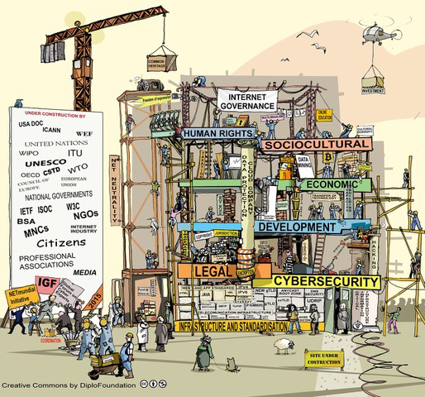
Internet Governance – Under Construction
truction
4 / 5

Slide 5
A Snapshot of Some of the Players in IG
Governments/Interna’l Orgs/Global Banks Technical Groups/Businesses NGOs/Civil Society, Media, Think Tanks,Academia,Individuals
World Bank/Int’l Dev Bank/African Dev. Bank
Businesses – Infrastructure, Platform, Social Media, Content
ECOSOC
World IT Services Alliance
UN
Access Now
Public Knowledge
Think Tanks – mostly US/EU
African IT Alliance
AfiCTA
ILO
WIPO
EC, African Union, APEC, OECD, DoE…
ITU
NGOs –engaged in development/Capacity Building
Colleges and Universities
UNCTAD
Inter’l Chamber of Commerce
Commission on Science/Tech for Dev
UNESCO
ICT and other business associations
Rotary/Lions Clubs/YMCAs/Libraries
ICANN\
Supporting Orgs/Adv Committees
Red Cross/Red Crescent; other dev organizations
Elected/Appt’d Policy Makers
Internet Society
UNWomen
Individual Citizens
Center for Democracy and Technology
DIPLO
Law Enforcement
Systems
National and Local Govts [200+national /
000’s/Local]
IEEE
GSMA
News and Media
National IGFs –e.g.
IGF-USA, African IGF; sub regional/national
+100 more…
Internet Governance Forum
Copyright 2018

Slide 6
Examples of “some” IG and Related Events - 2018
IGF-MAG
19-21 Mar. Geneva
UB GA
CSTD-EC 29-31 Jan. Geneva
UNCTAD E-COMS 16-20 Apr. Geneva
CSTD Plen. 14-18 May Geneva
ECOSOC STI Forum 5-6 June New York
ECOSOC HLPF (SDG) 9-18 July New York
UN GA HL Segment 18-25 Sept. New York
UN/UN
Related
WSIS
19-23 Mar. Geneva
Telecom World 10-13 Sept. Durban
ITU PP
18- 29 Oct-1-16 Nov
Dubai
ITU-CWG 17-26 Jan. Geneva
COM-ITU 26-29 Mar
. Copenhagen
ITU
ICANN61 10-15 Mar. San Juan PR
GDD Summit
14-18 May BC, Canada
ICANN62 25-28 June Panama
ICANN63 20-26 Oct.. Barcelona
ICANN
CyFi, Nov.
India
IGOs
WIPO Trademarks 23-26 Apr. Geneva
61%
Paris Peace Forum – Nov 14
OECD-CDEP 16-18 May Paris
AfiCTA Summit
Oct 8-9
Kenya
IGF 2018
Paris, France
Nov 15-17
UN SecGen
Working Group on Digital Cooperation
Wuzhen IG Conf. Dec. ??
I&J CONF
16-18 Feb. Ottawa
Various National IGFs – thru year
Studienkreis 30-31 Aug. Tallinn
Other/ IG related
MWC
26 Feb.-2 Mar.
Barcelona
G7 (ICT Innovation)
8-9 June Canada
G20 Summit 30/11-1/12 Buenos Aires
JAN | FEB | MAR | APR | MAY | JUNE | JULY | AUG | SEPT | OCT | NOV | DEC
Chart “under construction” and offered for illustrative purposes only. Dates often change/current as of Oct 2018.
Notes:
To adjust the length of each colored bar, click the bar, ensuring the bar is highlighted, grab a corner and length or shorten, depending on your preference.
To revise the year or text boxes, simply replace, all are editable.

Slide 7
Policy and Technology Issues Continue to Emerge – Highly Interdependent
Cyber Security
Privacy of Data
Access
Digital Literacy
IDNs
Non English Content Online
Fragmentation of the Internet
Cyber Crime
Protecting Children Online
Cyber Warfare
Internet of Things
Abuse/Misuse of Social Media
Energy
Health Care
Gender
Education
......

Slide 8
Only One Example : Understanding the Challenges –Access and Beyond - Access and Digital Literacy are Basic Building Blocks
47% of World’s people – 3.9 Billion - now use the Internet – up from 43% in 2017
  35.2 % Penetration in Africa – significant growth over last 5 years
  [Rest of World Penetration – 58.4%]
  Wide gaps across the Continent – from -5% in Niger to 85% in Kenya
  2 Billion Facebook users across Continent
3.9 Billion people – world wide do not use the Internet - Challenge to reach UN goal of 60% of world’s population online by 2020
Digitization of work creates challenges all countries/especially Africa’s goals of a better economic and social future for all Africans
“Mere” access is not enough – Digital literacy, content in multiple languages, changes in educational systems, financial services for under served

Slide 9
Enhancing AfiCTA’s Presence and Engagement in IG Activities and Events - Examples
ICANN
IGF and national IGF Initiatives *
WSIS Forum
Joining national government delegations – ITU, United Nations, CSTD…
UNCTAD e-Commerce Week
United Nations Working Group – Digital Cooperation – Public Comment Process – Very short deadline
USTTI – United States Telecommunications and Technology Institute

Slide 10
NRIs – world wide – courtesy of IGF Focal Point

Slide 11
*A Quick “look” at a few of AfiCTA’s engagements to date in IG EcoSystem
Appointment of multiple business leaders to the IGF MAG – over a number of 3 year cycles: Waudo Siganga; Jimson Olufuye; Hossam Elgamai; Paul Rowney
AfiCTA leadership recognized as opening/closing sessions as one of two business high level speakers
Invited speaker at WSIS Forum High Level sessions
Leadership and engagement from AfiCTA in ICANN Business Constituency and Cross Community Working Groups and ICANN Fellowship Program
Appointment by UN Secretary General to the UNCTAD Commission on Science and Technology [CSTD] to three Working Groups – IGF improvements; Enhanced Cooperation
Participation in ITU PP delegations and some national consultations re ITU Sector events
Leadership/participation in different national IGFs

Slide 12
Looking Ahead – Enhancing AfiCTA’s Continued engagement in the IG EcoSystem
Strengthen the engagement with global providers and International organizations seeking to build presence in Africa
Create a strategic engagement with the ICANN Africa office in Kenya/meet with ICANN business engagement VP at each ICANN meeting to strengthen /enhance ideas for business engagement in Africa
Continued focus on ICANN Business Constituency engagement/leadership for AfiCTA members
Enhance relationship with UNCTAD’s e-commerce program
Continued engagement with national and sub regional and regional IGF, global IGF with a focus on more visibility and engagement from Africa
When new IGF MAG is announced [expected by November], have an African specific informal engagement, led by present African MAG members [Paul Rowney, AfiCTA Board is a MAG member].
Consider developing a WSIS Forum strategy to seek high level speaking roles for business leaders from AfiCTA

Slide 13
Questions/Comments/Discussion
Marilyn S. Cade
ICT Strategies – mCADE llc
marilynscade@hotmail.com
SKYPE : mscade.ictstrategies

